Slide 1
AFWA Fish and Wildlife Agency Survey on Artificial Intelligence (AI) and Machine Learning (ML)
3/31/2026

Slide 2
Purpose
Identify the utilization of Artificial Intelligence (AI) and Machine Learning (ML) within state, provincial, territorial fish and wildlife agencies.
Understand challenges and success stories associated with AI/ML use.
Assess what policy, budgetary, ethical, and communication factors are being considered.
Share what we learn with AFWA member organizations.

Slide 3




Background Information
Development
Pilot
Distribution
Directions
Survey content developed collaboratively with input from Science & Research Committee, Conservation Business Practices Committee, Tech & Data Subcommittee, Social Science Subcommittee
7 AFWA member organizations contacted (December)
Improved survey based on their feedback
AFWA distributed an invitation email with a link to take the online survey along with 2 reminder emails (February)
Email listserv comprised of AFWA member organizations directors, representing states, provinces, and territories (n=67)
1 response per AFWA member organization
Collaboration on responses within an agency was encouraged, but leadership was directed to identify 1 point person to submit a survey

Slide 4
Response Overview
Response Rate
Completion Time
Collaboration
47.8%
Median:
15 minutes
40.6%
32 AFWA member organizations represented
40 responses submitted (n=9 removed from analysis)
Average response time of 34 minutes due to a few surveys left open for long periods of time
Just under half of respondents collaborated with others in their agency to submit a response
Notes:
Note: For organizations that submitted multiple responses instead of 1, all respondents were contacted via email and informed that the multi-select and open-ended responses from their organization were collated. Each respondent was asked if they felt like they were the best representative for the single-select response options. In the end, only one respondent was selected to represent the organization for single select options if submitted responses diverged. *This situation only happened with one organization.
9 responses removed from analysis due to blank submission (1), multiple entries from one agency (3), and no agency/location information provided making it impossible to verify if it was multiple submissions from one agency or unique submissions (5).

Slide 5
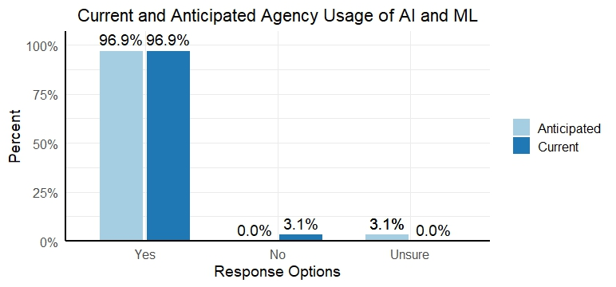
Current and Anticipated Use of AI and ML
Notes:
Anticipated = within the next 2 years

Slide 6
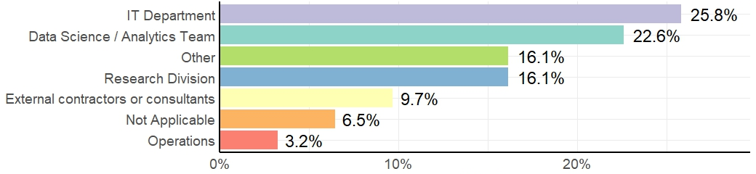
Where AI and ML Activities are Primarily Housed in an Agency
Notes:
Other options listed: Throughout agency (not housed in one specific part of agency – re: conversation or assistant AI), state centralized IT agency, at the division level, Both IT and Operations

Slide 7
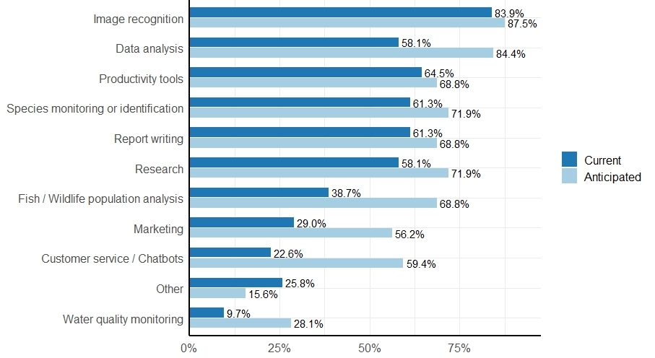
Current and Anticipated Ways Organizations are using AI and ML
Notes:
This question had a multi-select response option. Respondents could "select all that apply".
Anticipated = within the next 2 years
Other options listed: license plate readers, grant writing, media creation or editing, staff support for email writing or answering questions, content summaries, staff recruitment, QA/QC, presentation creation, land surveys

Slide 8
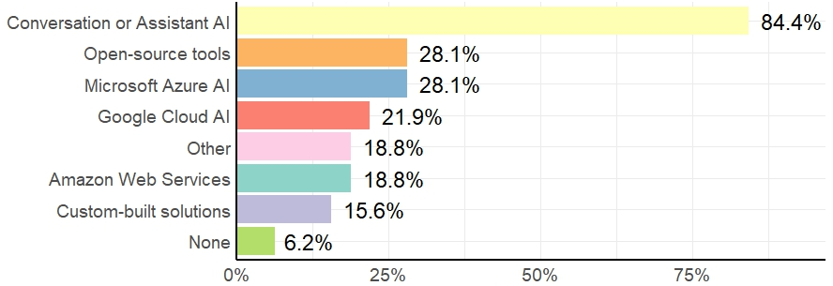
Tools, Platforms, Technologies Used to Implement AI or ML
Notes:
This question had a multi-select response option. Respondents could "select all that apply".
The response option 'Conversation or Assistant AI' was listed with examples like ChatGPT and Co-Pilot. The response option 'Google Gemini' was included in this category.
The response option 'Open-source tools' was listed with examples like TensorFlow and PyTorch.
Other options listed: Python, Addaxai, Birdnet, Qualtrics, FLOCK cameras, legal-based AI, wild-trax

Slide 9
Measuring Effectiveness or Success
Qualitative Evaluation
Quantitative Evaluation
No Formal Evaluation
Ease of use
Perceived efficiency by users
Quality of outputs
Perceived user success
Amount of time saved
Accuracy of models or outputs
Cost savings
Adoption rates among staff
Nothing in place to evaluate or measure success as it relates to agency use of AI and ML

Slide 10
Identified Limitations
Monitoring Proper Use
Data Accuracy
Staff Limitations
Infrastructure or Tools
Humans are still needed to vet the data
Sensitive outputs depend on asking the right questions
Significant work to get staff trained
Varying internal perceptions of utility which either propels work or stalls it
Limits on funding, staffing, or infrastructure make new pursuits inaccessible
Some state IT agencies have not enabled access to tools
Ensuring staff are adhering to guidelines takes significant resources
Identifying new platforms and vetting them takes significant resources

Slide 11
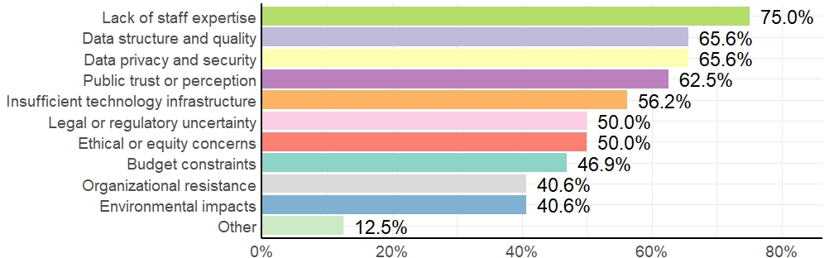
Challenges, Risks, and Concerns for Use of AI and ML
Notes:
This question had a multi-select response option. Respondents could "select all that apply".
Other options listed: needing “correct” sentence syntax, lack of staff capacity, poor existing tool performance, accuracy of outputs, energy demand conflicts with agency mission

Slide 12
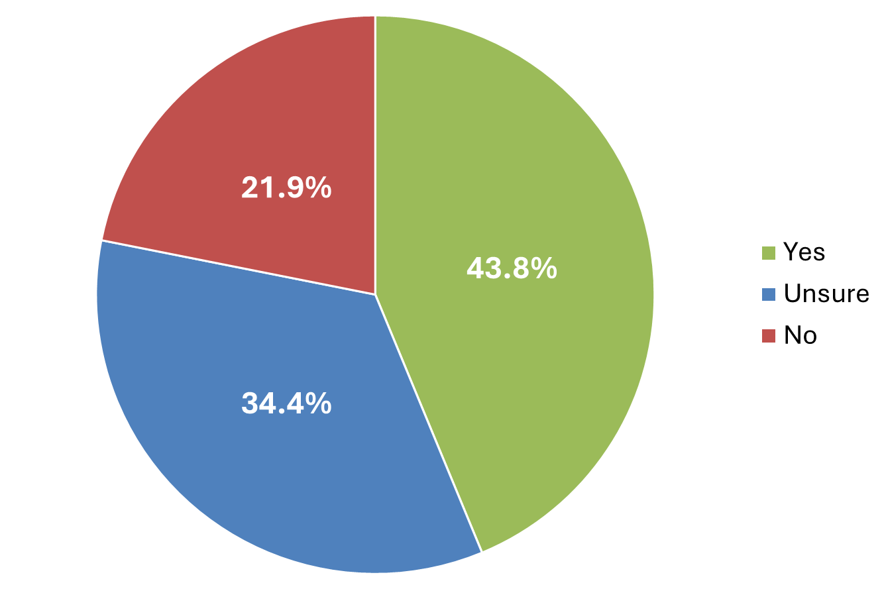
Consideration of Ethical, Cultural, or Equity Concerns

Slide 13
How Ethical, Cultural, or Equity Concerns are Handled
Formal Processes
Considerations
Internal Discussions
Follow external IT agency guidance and policies
Review committees that evaluate use of AI/ML
Specific rules for data use and tool disclosures
Ensuring equitable use and minimizing bias
At beginning phase of addressing concerns internally
Maintaining public trust and how to communicate
Notes:
Only respondents who selected "yes" or "unsure" to ethics question (slide 12) were asked this question.
Takeaway: not formally addressed by majority of agencies

Slide 14
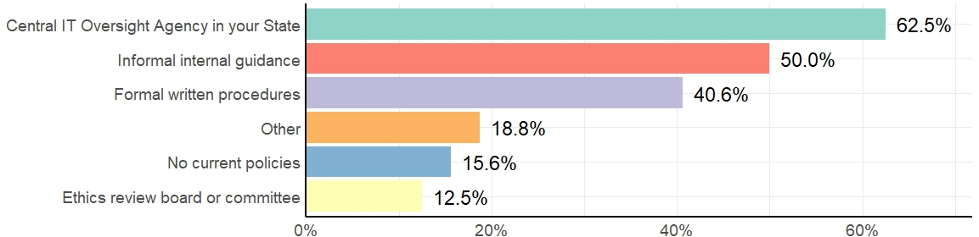
Policies, Guidelines, or Oversight Mechanisms in Place
Notes:
This question had a multi-select response option. Respondents could "select all that apply".
Other options listed: in the process of creating formal guidelines/policies, unsure, adapted other IT policies for AI

Slide 15
Measures taken to Ensure Data Privacy, Security, and Responsible Use
Formal
Protocols
Data
Considerations
Restricted
Access
Training
Defines responsible use
Agency developed or state generated guidelines and approval processes
Removal of any PII
No entry of sensitive data or PII into programs/software
Multi-Factor Authentication and data quality assessments for protection
Formal programs (internal and external to the agency)
Informal or on-the-job learning
Agency or state/province generated restrictions to accessing tools/programs
Internal vetting /review process for usage approval
Monitoring staff usage

Slide 16
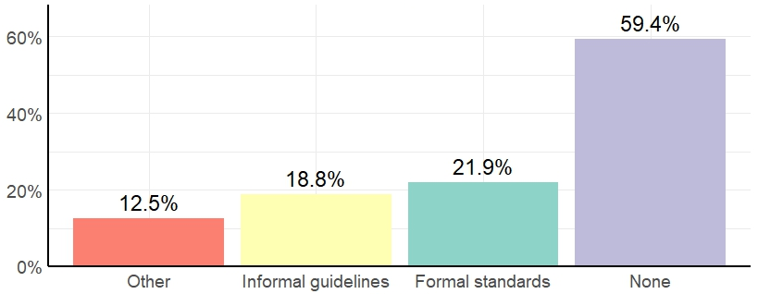
Standards or Prerequisites for Datasets Used in AI and ML Projects
Notes:
This question had a multi-select response option. Respondents could "select all that apply".
Other options listed: not using AI for data projects yet, formal agency data standards provide coverage for AI/ML use, standards vary on data collection and analysis

Slide 17
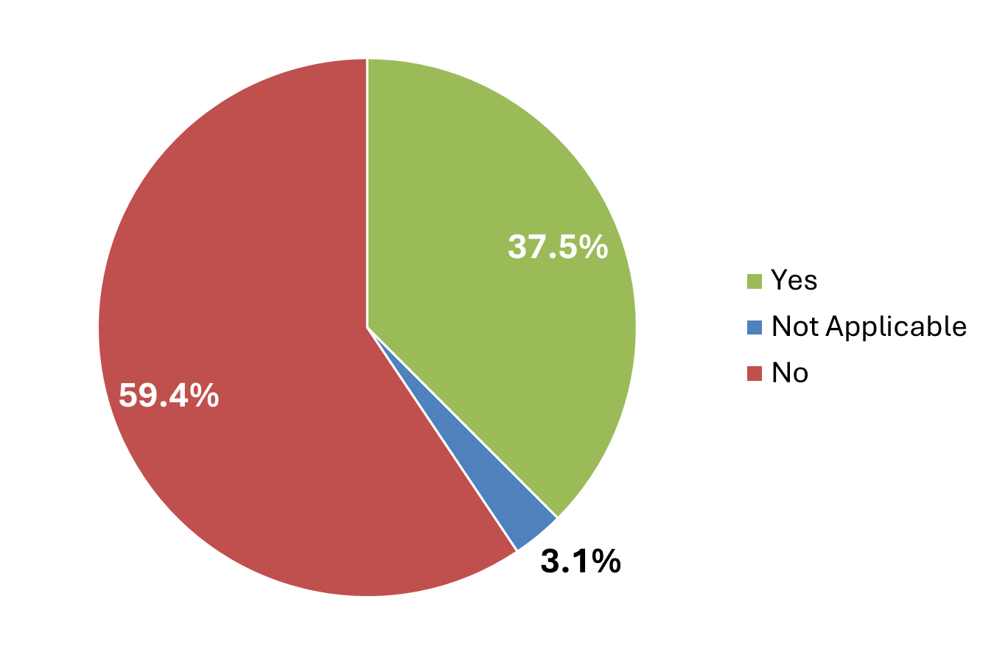
Training Provided or Requiring Specific Skill Sets for Staff working with AI and ML

Slide 18
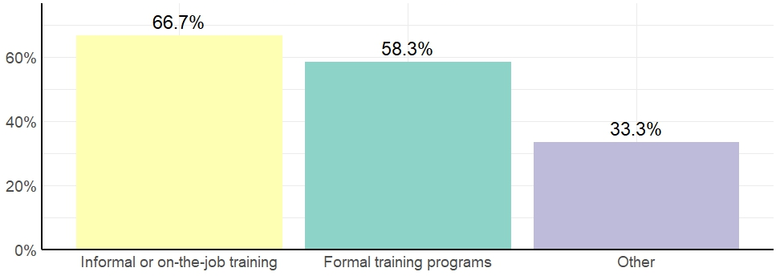
Types of Training Provided
Notes:
Only respondents who selected "yes" to training question (slide 17) were displayed this question.
This question had a multi-select response option. Respondents could "select all that apply".
Other options listed: piloting training with subset of user base, Pluralsight, short classes, external training for conversation/assistant AI

Slide 19
Communications about Adopting AI and ML
Internal
External
AI policy that staff must read and sign, agency developed guidelines/trainings
Emails, internal teams/working groups, staff presentations
AI conference or workshop attendance
Informal discussions
State IT governmental declarations
Statewide guidance and policies staff can refer to
Largely, no communications from an agency to the general public

Slide 20
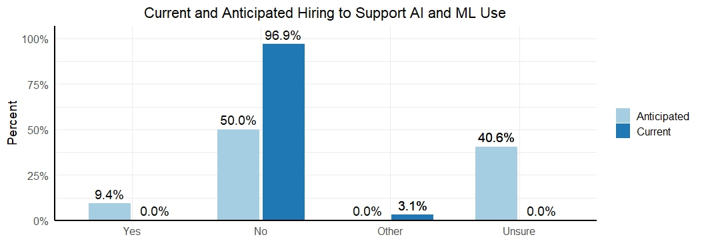
Current and Anticipated New Positions/Hirings to Support AI and ML Use
Notes:
Other options listed: reviewing existing staff skills and job descriptions to update roles and incorporate AI/ML
Anticipated = within the next 2 years

Slide 21
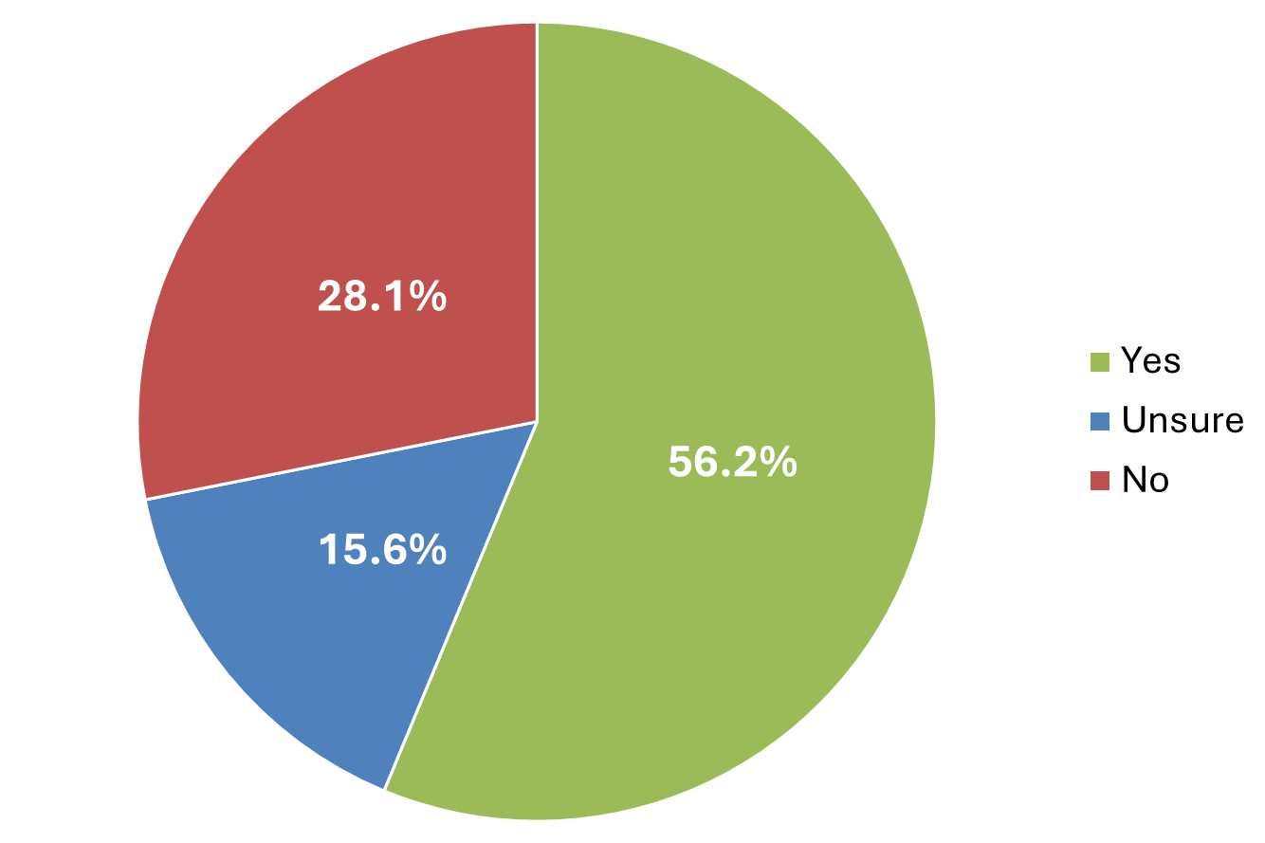
Collaborations with Other Organizations on AI and ML

Slide 22
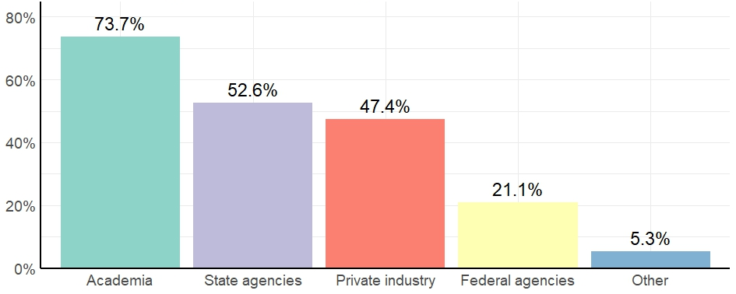
Types of Organizations
Agencies are Collaborating With
Notes:
Only respondents who selected "yes" to collaboration question (slide 21) were displayed this question.
This question had a multi-select response option. Respondents could "select all that apply".
Other options listed: NGOs

Slide 23
Opportunities for AI and ML to Transform Fish and Wildlife Conservation
Increased Efficiencies
Turning Data into Action
Better Constituent Engagement
Expanding Agency Capabilities
Handling large data sets
Saving staff time and increasing productivity
More frequent or consistent assessments
Reducing time between data collection and results
Summarizing results into action-oriented communications
Freeing up staff time to focus on implementing results
Accurate language translation services
Converting technical science reports into public communications
Customized messaging or customer service experiences
Accessing hard-to-reach areas
Predictive modeling and future forecasting
Performing tasks that have long been sidelined
Cost savings

Slide 24
Ways AFWA Can Support AI and ML Use
Communications / Collaborations
Trainings / Workshops
Information Repository
Develop BMPs
Guide agencies on their use of AI and ML
Promote research into best practices and ways to utilize AI and ML
How to vet new tools/programs, considerations for ethical, culture implications, communications with the public
Newsletter with frequent updates
Case studies that highlight work at agencies and "lessons learned"
Create a working group or community of practice
Specific to fish/wildlife agencies and their work
Skill building for staff, funded by AFWA
Training guides for a-synchronous learning
Share templates, programming code, programs/tools and their uses
Access to agency policies and guidelines
Share job descriptions
Notes:
Miscellaneous comments worth noting: promote opportunities to cost-share AI/ML tools or buy-in with other states, "Support of large language models focused on wildlife and vetted by scientific research"

