Slide 1
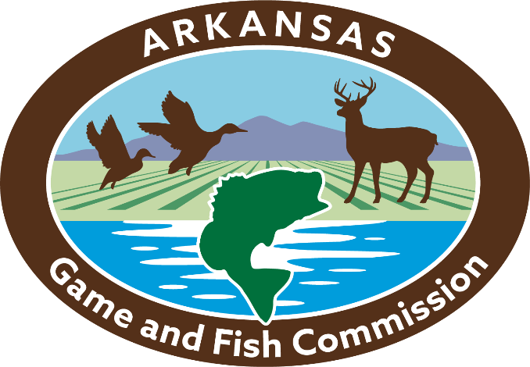
Fish & Wildlife Coordination Act
Intergovernmental Relations Committee
April 19, 2023
Jennifer Elise Sheehan

Slide 2
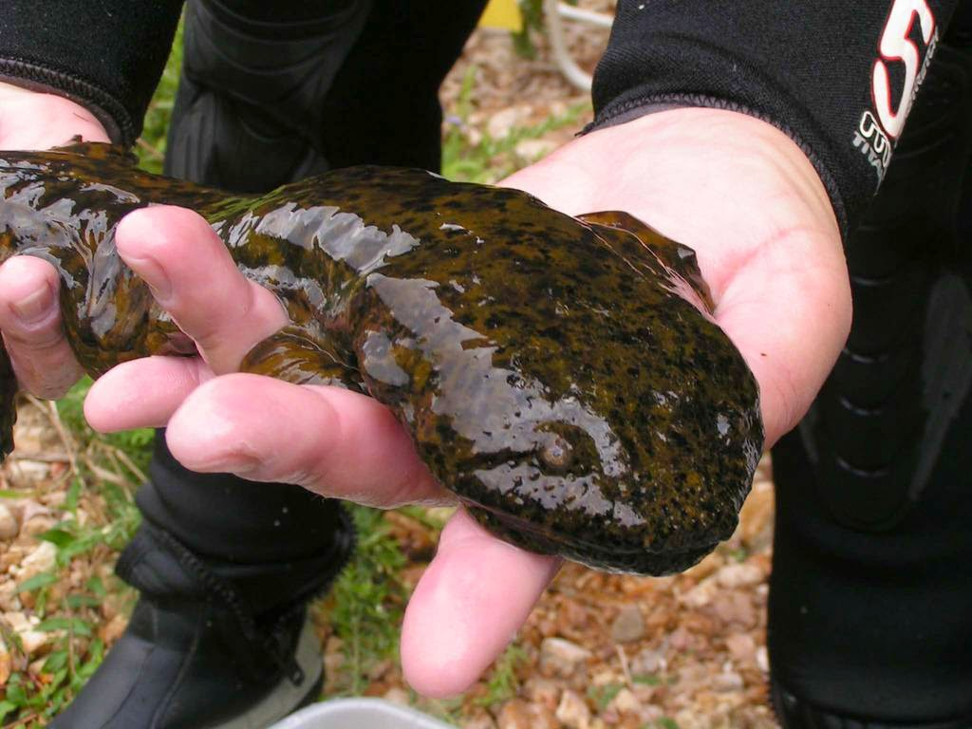
Fish & Wildlife Coordination Act
(FWCA)
Enacted in 1934
Intent to protect fish and wildlife, and give them equal consideration with other project features, when a federal action results in the modification of a water body
1946 amendments require the coordination between the federal action agency, the U.S. Fish & Wildlife Service (Service), and the State wildlife resource agency where the project is occuring
1958 amendments allowed for fish and wildlife to be the authorized purpose of a federal water development project
Notes:
I’m here to talk to you about the Fish & Wildlife Coordination Act. As with most federal laws it has a long name so in the interest of time you’ll hear me refer to it as the, “Act” or by its acronym, FWCA.
The Fish & Wildlife Coordination Act was originally enacted in 1934
It targets federal water development projects
It’s purpose was to ensure equal protection for fish and wildlife resources with other project benefits
The 1946 amendments require coordination with the U.S. Fish & Wildlife Service and the state wildlife agency
The 1958 amendments allow fish and wildlife to be the authorized purpose of a project

Slide 3
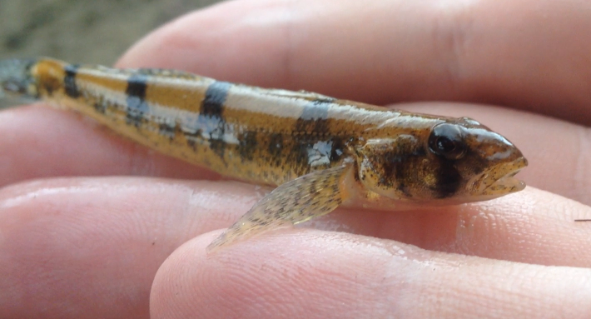
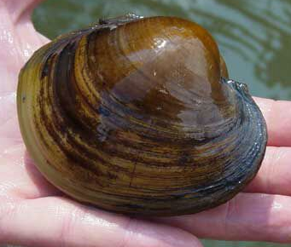
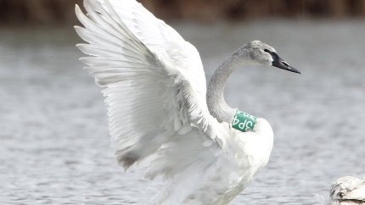
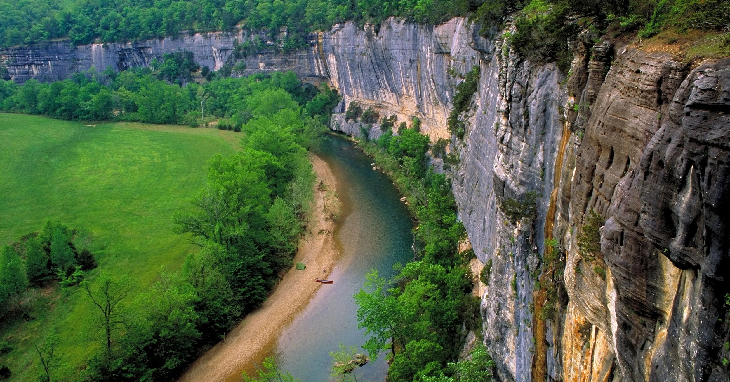
What did FWCA mean by “Wildlife” and “Wildlife Resources?”
“... include birds, fishes, mammals and other classes of wild animals and all types of aquatic and land vegetation upon which wildlife is dependent.”
Notes:
What does the FWCA mean by “wildlife” and “wildlife resources:”
It is to, “... include birds, fishes, mammals and other classes of wild animals and all types of aquatic and land vegetation upon which wildlife is dependent.”

Slide 4
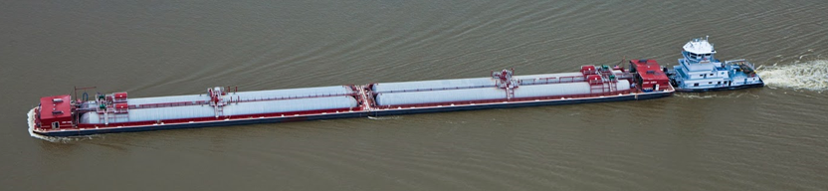
Fish and Wildlife Coordination Act
16 U.S.C. § 662(2)(a)
“…whenever the waters of any stream or other body of water are proposed or authorized to be impounded, diverted, the channel deepened, or the stream or other body of water otherwise controlled or modified for any purpose whatever, including navigation and drainage, by any department or agency of the United States, or by any public or private agency under Federal permit or license, such department or agency first shall consult with the United States Fish and Wildlife Service, Department of the Interior, and with the head of the agency exercising administration over the wildlife resources of the particular State wherein the impoundment, diversion, or other control facility is to be constructed, with a view to the conservation of wildlife resources by preventing loss of and damage to such resources as well as providing for the development and improvement thereof in connection with such water-resource development.”
Notes:
This is a portion of the 1946 amendment that requires the federal agency engaging in a water development project, which includes any activity funded, licensed, or permitted, to consult with the U.S. Fish & Wildlife Service and, “... the head of the agency exercising administration over the wildlife resources of the particular State….” In Arkansas, that’s the Arkansas Game & Fish Commission.

Slide 5
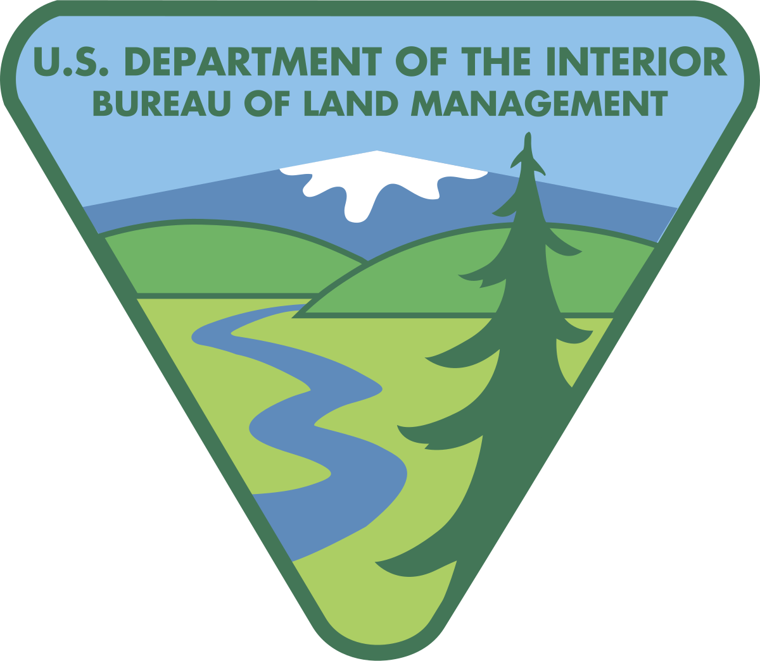
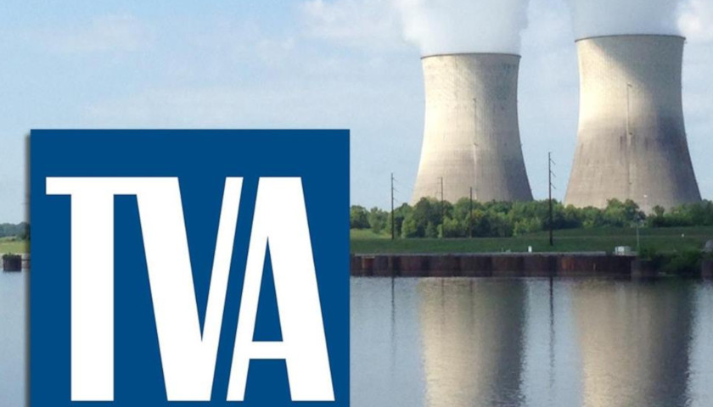
Projects Exempt from FWCA
Projects of the Tennessee Valley Authority
Impoundment of water where the resulting surface area is less than 10 acres
Land management activities carried out by federal agencies on federal land
Notes:
Projects that are exempt from the Fish & Wildlife Coordination Act:
Projects of the Tennessee Valley Authority
Projects that impound water on federal lands where the surface area is less than 10 acres and
Land management activities conducted by federal agencies on federal land

Slide 6
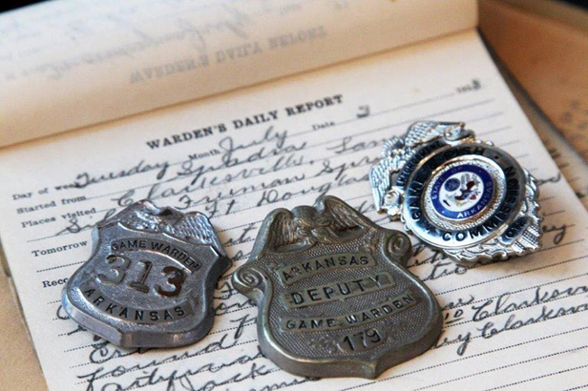
Penalties for not complying with FWCA
Considered a misdemeanor
$500 fine
  Later increased to $100,000 for individuals and $200,000 for organizations
Up to a year in prison
Notes:
Not complying with the Fish & Wildlife Coordination Act is:
Considered a misdemeanor
Carries fines upwards of $100,000 and
Could include up to a year in prison

Slide 7
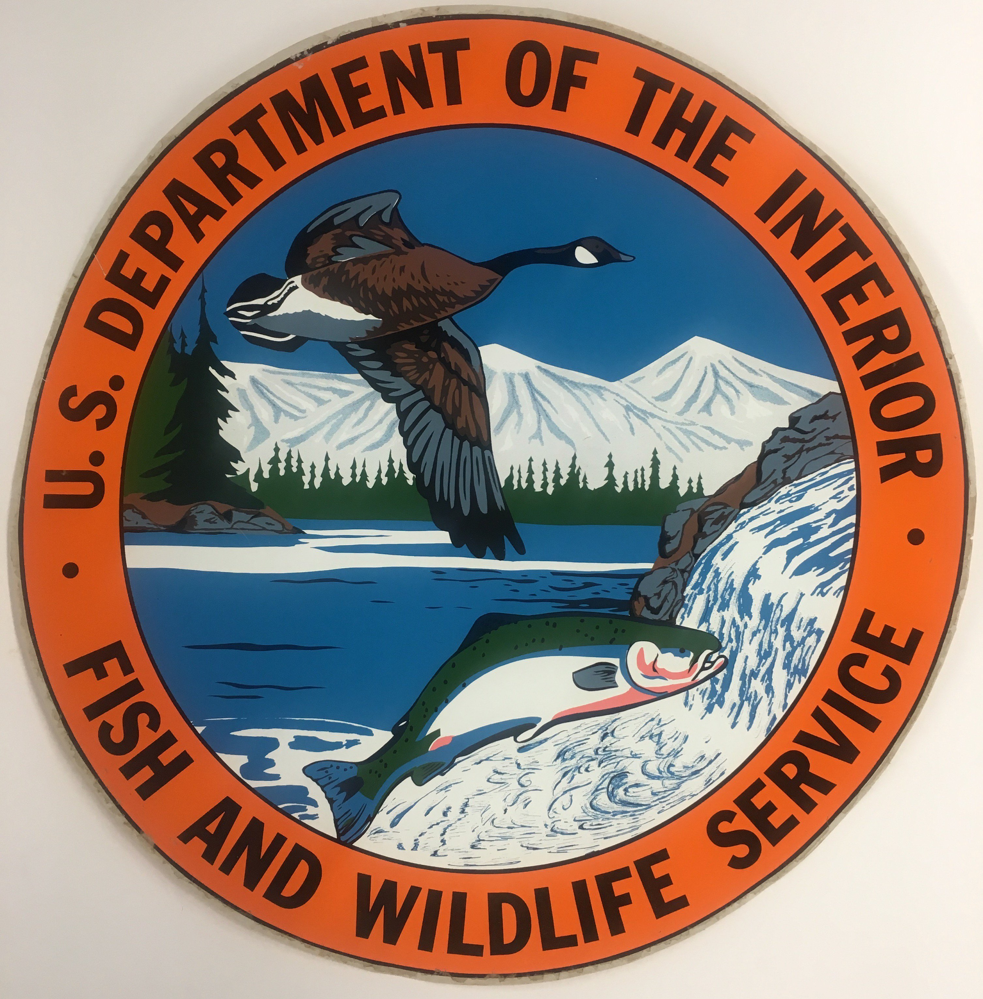
What did FWCA look like at the federal level?
U.S. Fish & Wildlife Service - Division of River Basin Studies
Created in 1946
Abolished in 1974
Responsible for ensuring adequate protection of fish and wildlife in areas affected by federally licensed water development projects
Notes:
What did the Fish & Wildlife Coordination Act look like at the federal level? Well, the Fish & Wildlife Service created the Division of River Basin Studies in 1946. Their job was to ensure that fish and wildlife resources were receiving the recommended protections from federal water development projects. That Division was dissolved in 1974.

Slide 8

What does FWCA Coordination look like at the
federal level today?
The Service has a guidance document that directs their review of federal water development projects under FWCA
The U.S. Army Corps of Engineers (Corps) must include FWCA reimbursement to the Service in their project budgets
MOA signed between the Corps and the Service in 2003
The Corps, together with the Service, is to select the contractors for a water development projects
The Service prepares a FWCA Report to the Corps
  The Service provides their position on the project
  Corps must respond in writing to the Service
  FWCA report included in Corps’ final report to Congress
The National Marine Fisheries Service also takes part in FWCA activities
Notes:
What does FWCA look like at the federal level today? There is an MOA between the Service and the U.S. Army Corps of Engineers that ensures FWCA coordination and even requires the Corps to reimburse the Service for time spent reviewing projects.

Slide 9
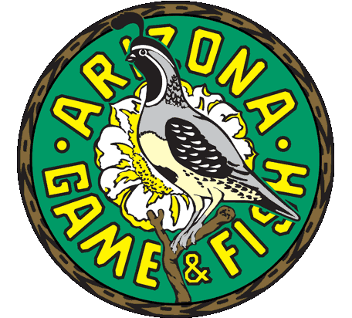
What about the States???
River Basins Grant - from the USFWS to the States for FWCA work
When the funding stopped did States forget about FWCA and their authorities under it?
Arizona Game & Fish Department survey
  Original survey - 19 States responded
  September 2019 survey - 26 States responded
  Sent to the Fish Chiefs of each State
Notes:
What about the States?
The Fish & Wildlife Service used to administer a River Basin grant to States for their work on FWCA coordination but that went away with the River Basin Division in 1974
Many States seemed to have forgotten about the Fish & Wildlife Coordination Act and assumed their project review authority was covered under other laws like the Clean Water Act and the National Environmental Policy Act
The Arizona Game & Fish Department had a not so great experience with the Corps of Engineers – Los Angeles District and decided to poll the States to find out what, if anything, they remembered about FWCA

Slide 10
Survey Questions Included:
Is your State agency familiar with the FWCA?
  Yes = 23, No = 3
Was FWCA consultation undertaken and a substantiating report submitted?
  Yes = 5, No = 18
Did the federal action agency transfer funds to the federal or State agency for FWCA consultation?
  Yes = 2, No = 20
Was State input given equal consideration with other features of the water development project?
  Yes = 13, No = 10
Do you feel the text of FWCA should be amended to better achieve the intent of the Act and clarify agency responsibility?
  Yes = 17, No = 6, No Opinion = 3
Notes:
The types of questions asked included:
Are you familiar with FWCA?
Was State input given equal consideration with other aspects of the project review?
And, do you feel the text of FWCA should be amended to clarify State responsibility?

Slide 11

Association of Fish & Wildlife Agency Efforts
“The Voice of Fish and Wildlife Agencies”
Fish & Wildlife Coordination Act
Working Group
Established in 2021
Working Group under the Fisheries and Water Resources Policy Committee
Notes:
This discussion ultimately led to the creation of a Fish & Wildlife Coordination Act Working Group through the Association of Fish & Wildlife Agencies. The Working Group operates under the Fisheries & Water Resource Policy Committee.

Slide 12
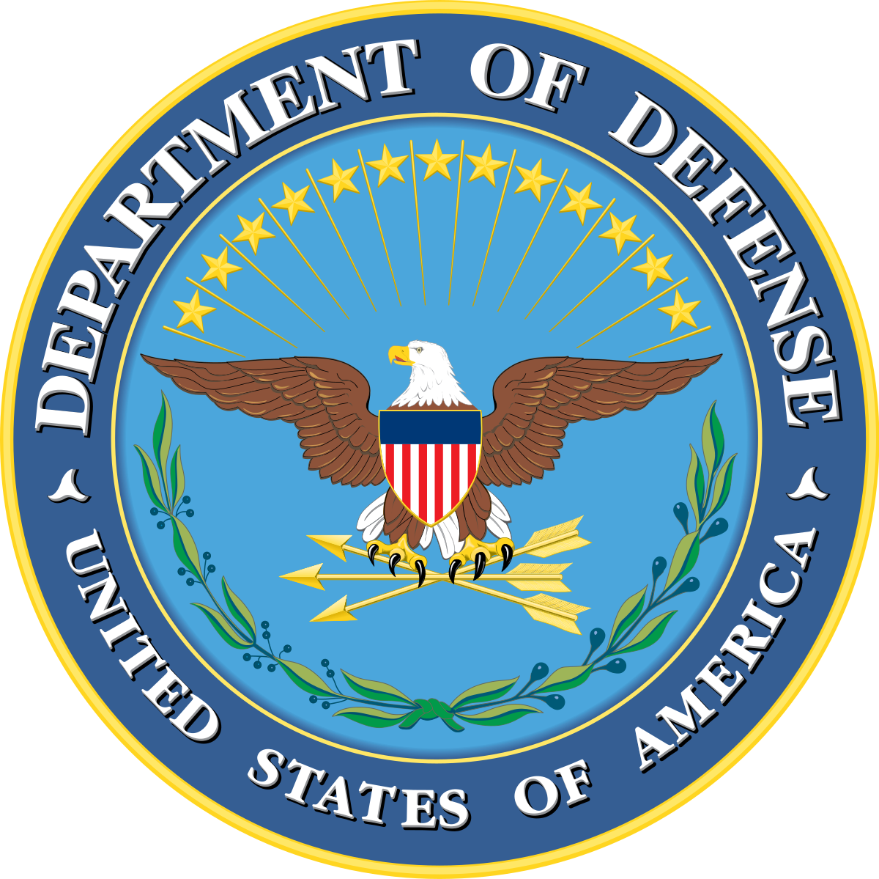
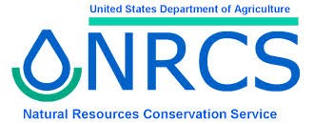
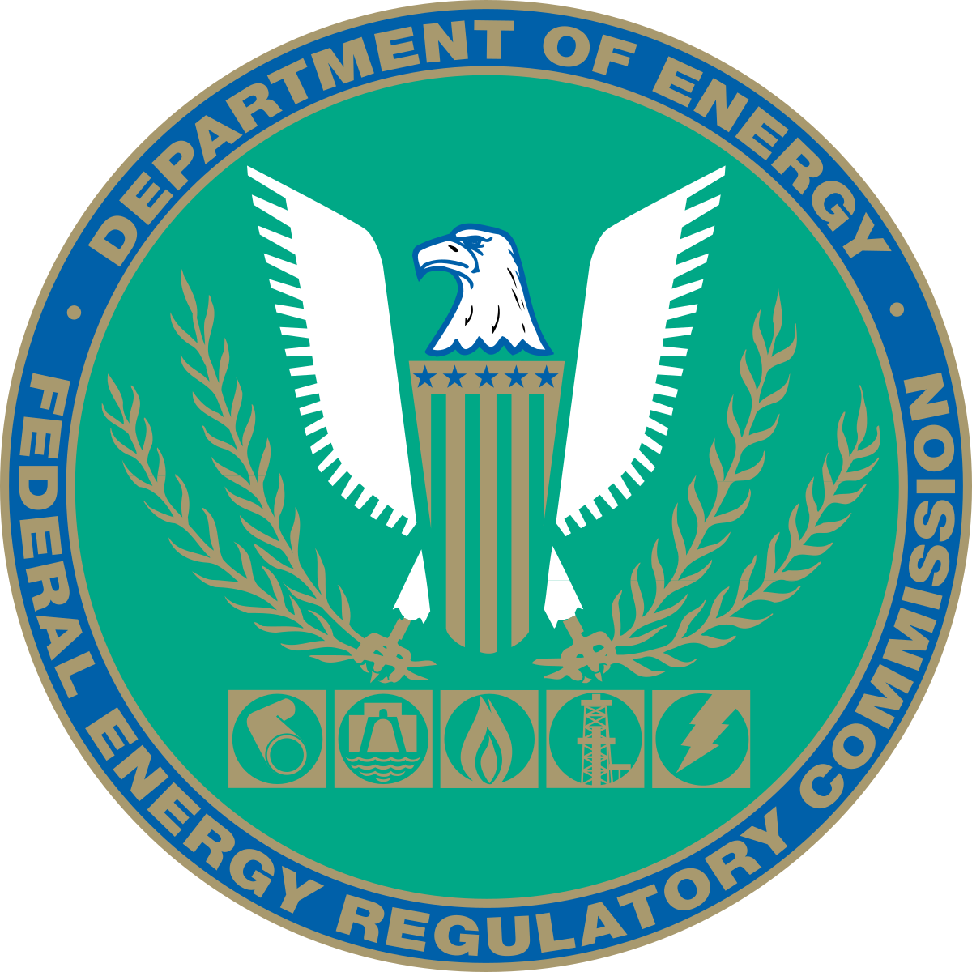
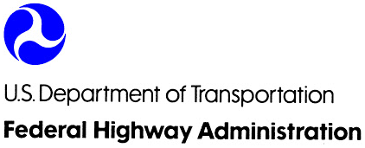

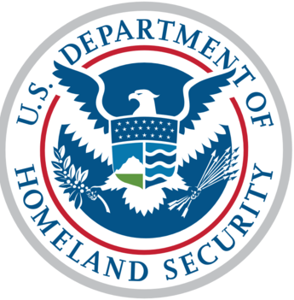
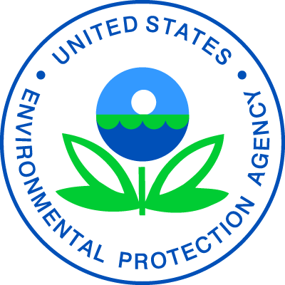
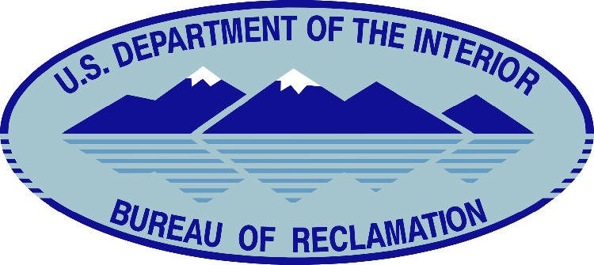
FWCA Working Group Goals
Education
Increasing understanding of FWCA scope and engagement
Increased cooperation between federal water development agencies, the U.S. Fish & Wildlife Service, and state wildlife agencies
Notes:
The Goals of the FWCA Working Group are
to educate state wildlife agencies about the Act and their authority under it
To increase the understanding about the types of projects that are covered under the Act and
Increase cooperation between federal and state agencies for the review of federal water development projects

Slide 13
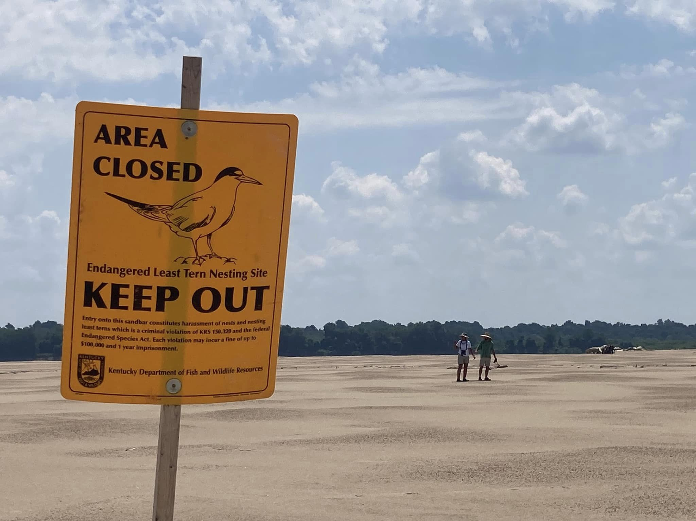
Questions?

